Slide 1
FDA Orphan Products Natural History Grants Program An Opportunity for APBD?
Harrison N. Jones, PhD
Associate Professor
Department of Surgery
Duke University
December 6, 2016

Slide 2
Thanks and Introduction

Slide 3
Glycogen Storage Disease Type II
Pompe disease (acid maltese deficiency) is classified based upon age of onset, disease distribution, severity, and rate of progression
Infantile-onset Pompe disease
Late-onset Pompe disease (LOPD)
Autosomal recessive metabolic disorder
Incidence: ~ 1 in 40,000
Enzyme replacement therapy (ERT)-Alglucosidase alfa (Myozyme, Lumizyme)
LOPD vs. APBD

Slide 4
Lingual Pathophysiology in LOPD 1
We first described the presence of lingual weakness in 2011 (“Expanding the phenotype of late-onset Pompe disease: Tongue weakness-a new clinical observation”)
Mild to severe lingual weakness in 19/19 consecutive subjects including 2 with asymptomatic disease
Quantitative follow-up in 2015 (“Quantitative assessment of lingual strength in late-onset Pompe disease”)

Slide 5
Lingual Pathophysiology in LOPD 2
40-month prospective trial funded by Genzyme Corporation
Do measures of lingual function and structure differentiate subjects with LOPD vs. other forms of hereditary/acquired myopathy vs. neuropathic controls?
FUNCTION: Tongue MMT and QMT
STRUCTURE: Tongue US

Slide 6
Effects of RMT in LOPD 1
Despite ERT, respiratory weakness remains the primary cause of morbidity and mortality in LOPD
Respiratory muscle training (RMT) appears safe and well-tolerated by LOPD patients (“Respiratory muscle training (RMT) in late-onset Pompe disease (LOPD): Effects of training and detraining”)
Large to very large effect sizes persistent to 3-month withdrawal
Pilot work did not seem to capture functional benefits associated RMT-induced respiratory strength increases
Pilot data are also uncontrolled

Slide 7
Effects of RMT in LOPD 2
3-year prospective, placebo-controlled randomized clinical trial-NIAMS NIH (R21)
28 LOPD subjects: RMT (n=14) vs. sham-RMT (n=14)
Optimal outcome measures to capture functional benefits associated with RMT-induced respiratory strength enhancements
Feasibility/utility of sham-RMT as a control condition for RMT
Patient Advocacy Committee-provided input regarding all aspects of trial, letters of support
Intended to lead to phase III efficacy trial (R01)

Slide 8
Orphan Products Research Project Grant R01; RFA-FD-16-043
Support research that advances rare disease product development
Characterization of the natural history of rare diseases/conditions
Identification of genotypic and phenotypic subpopulations
Development/validation of clinical outcomes, biomarkers, and/or companion diagnostics

Slide 9
What would a strong grant application look like?
Multi-site, international team of investigators with access to the patient population and proven ability to collaborate
Ongoing input from a Patient Advocacy Committee
Establish and measure a core set of standardized outcome measures that comprehensively captures effects of APBD
Lower extremity signs and symptoms
Lower urinary tract signs and symptoms
Cognitive signs and symptoms

Slide 10
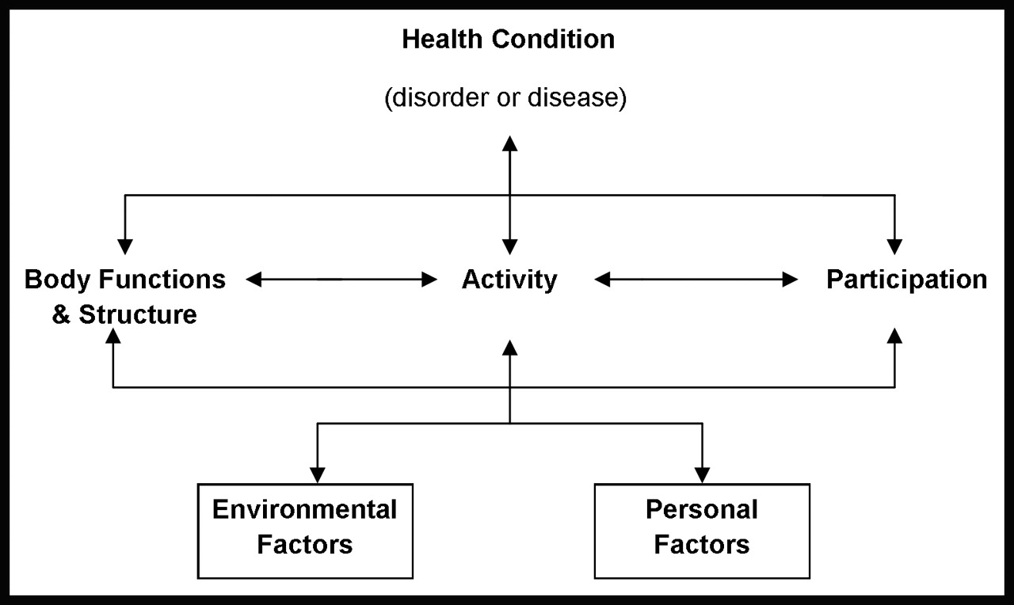
ICF Model of Disablement

