Slide 1
APBD Patient Registry

Slide 2
APBD Patient Registry
Established May 1, 2014
Open to patients and immediate family members
Collected Demographic data, family history, clinical observations, and the results of physical and neurological examinations
Does not replace clinical trials but very important to assess natural history and source of recruitment

Slide 3
APBD Patient Registry – How Information is Protected
Patient data are encrypted and stored in secured servers with 24/7 security by Columbia University
Access to the data is by authorized Columbia University personnel, using secured passwords
Only de-identified data is provided to authorized parties who have been approved by the APBD Research Foundation in accordance with federal regulations
Patients can request to enroll anonymously and/or limit the data they provide
All direct communication with enrollees with done only through the Columbia team

Slide 4
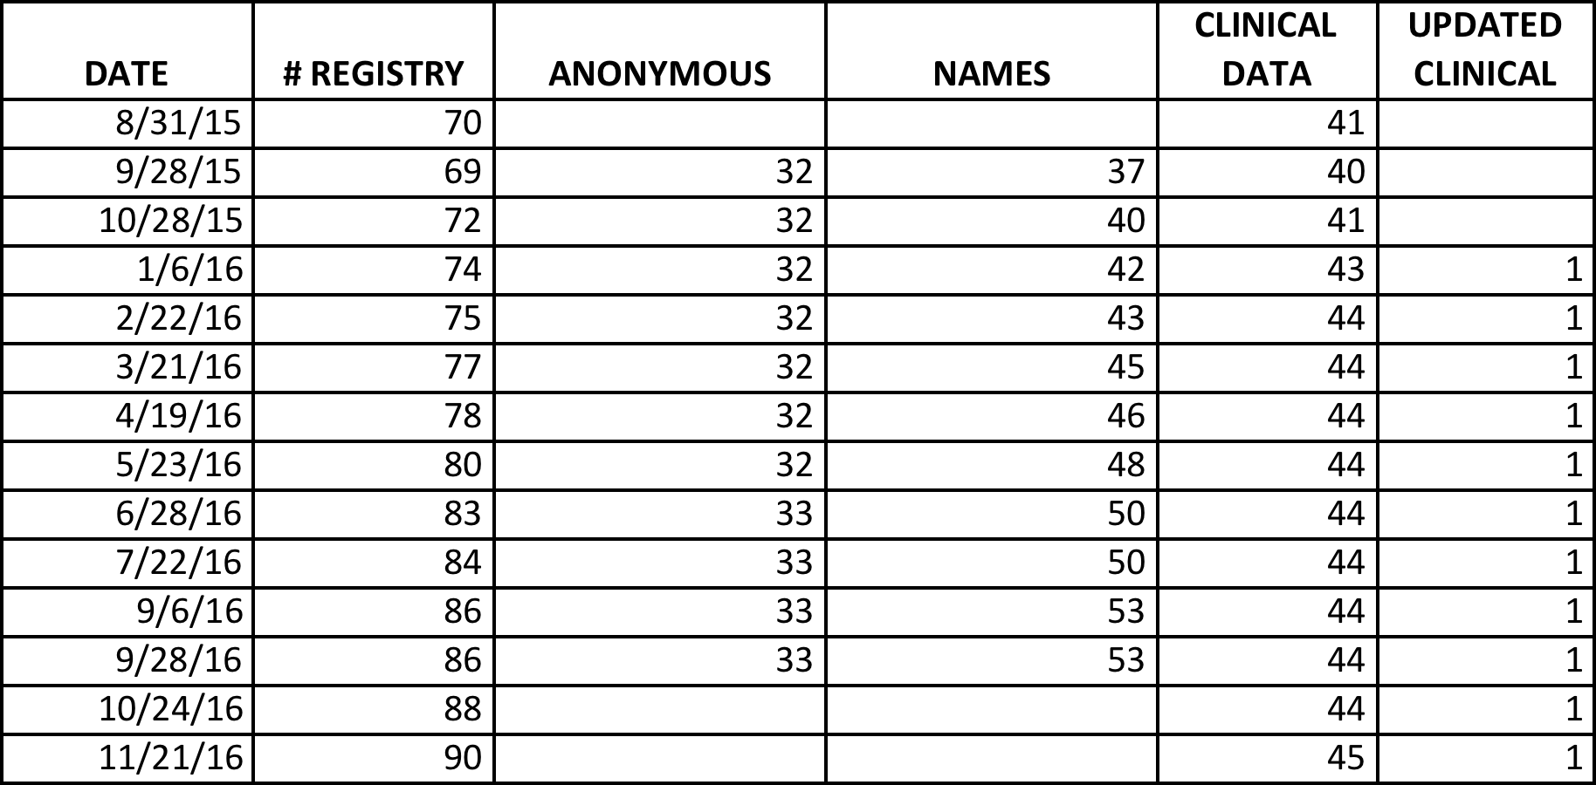

Slide 5
